Slide 1

Identifying Vulnerabilities in VS Code Extensions : Supply Chain Attack
Team 6

Slide 2
VS Code and Extensions
VS Code built using the Electron framework
Create cross-platform desktop applications
Uses HTML, CSS, and JavaScript.
Chromium for rendering web content.
Node.js for accessing native system resources (API calls).
VS Code Extensions
Adds functionalities to making coding easier.
TypeScript or JavaScript.
Most extensions in JS, sometimes wrapped around TS.
TS more secure than JS.
Static typing
Strict syntax
Tooling support.

Slide 3
Inspiration
Identify, analyze and test extensions of VS Code from a security breach point of view.
Not targeting typosquatting type of attacks.
Possible in VS Code.
VS Code - popular text editor.
Immense user base – 14 millions active users (mostly developers).
Extensions (third party) to enhance functionality.
Pose security risks if not properly tested and validated.
Why this project:
Supply chain attacks on the rise.
Developer machines can contain important credentials.
Extensions run with user privileges, without sandbox.
Security experts warn about potential threats in the future.

Slide 4
Phases
Phase 1: Extension Selection.
Selecting extensions using official statistics, community feedback.
Phase 2: Vulnerability Identification.
Analyzing selected extensions for potential security vulnerabilities.
Phase 3: Vulnerability Exploitation.
Attempt to exploit identified vulnerabilities in selected extensions.
Determine their potential impact.
Make remediation recommendations based on the findings.
Phase 4: Grouping Vulnerabilities & Automate Detection.
Grouping extensions according to their underlying technology or coding practices.
Phase 5 : Reporting and Recommendations.
Prepare a report that summarizes findings and recommendations.

Slide 5
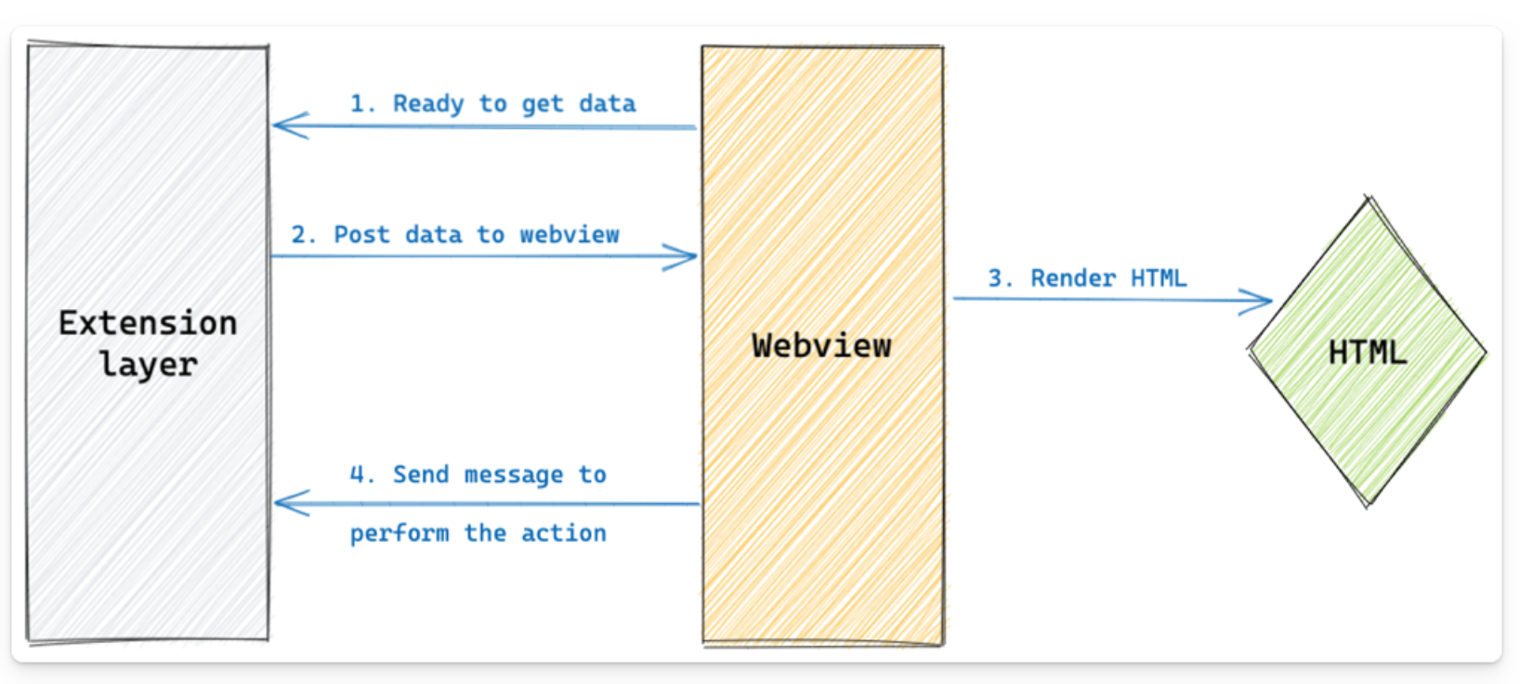
Related Work
Related Work: 06 Articles – 02 in 2021, 02 in Jan 2023, 02 Feb 2023.
Vulnerabilities in extensions creating a local server on the system.
Microsoft Live Preview¹ - Path Traversal Vulnerability
Microsoft SARIF Viewer¹ - Path Traversal Vulnerability
LaTex Workshop² - Code Execution
Open in Default Browser² - Path Traversal Vulnerability
Instant Markdown² - Path Traversal Vulnerability
Rainbow Fart² – Zip Slip Vulnerability
[1] https://blog.trailofbits.com/2023/02/21/vscode-extension-escape-vulnerability/
[2] https://snyk.io/blog/visual-studio-code-extension-security-vulnerabilities-deep-dive/

Slide 6
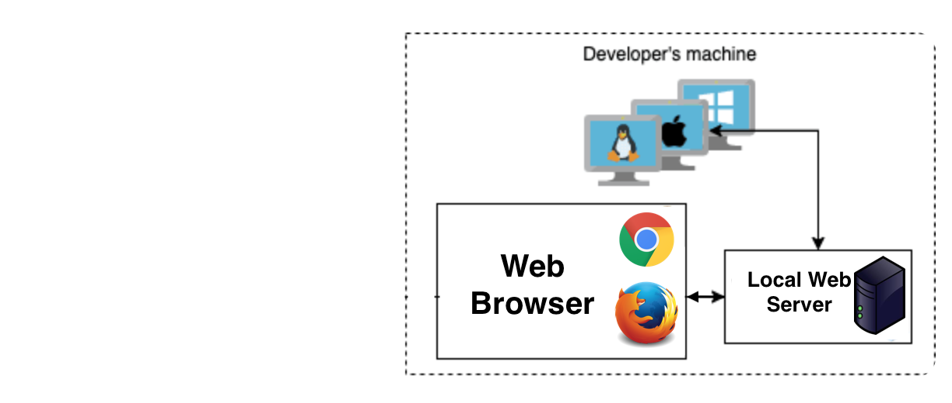
Identifying Target
Extensions running local web server on the machine.
Extensions avoiding options to make webviews secure.
enableScripts, localResourceRoots, Content-Security-Policy
Basic issue: Unsanitised inputs!!
Challenges
Find a vulnerable extension and exploit the extension.

Slide 7
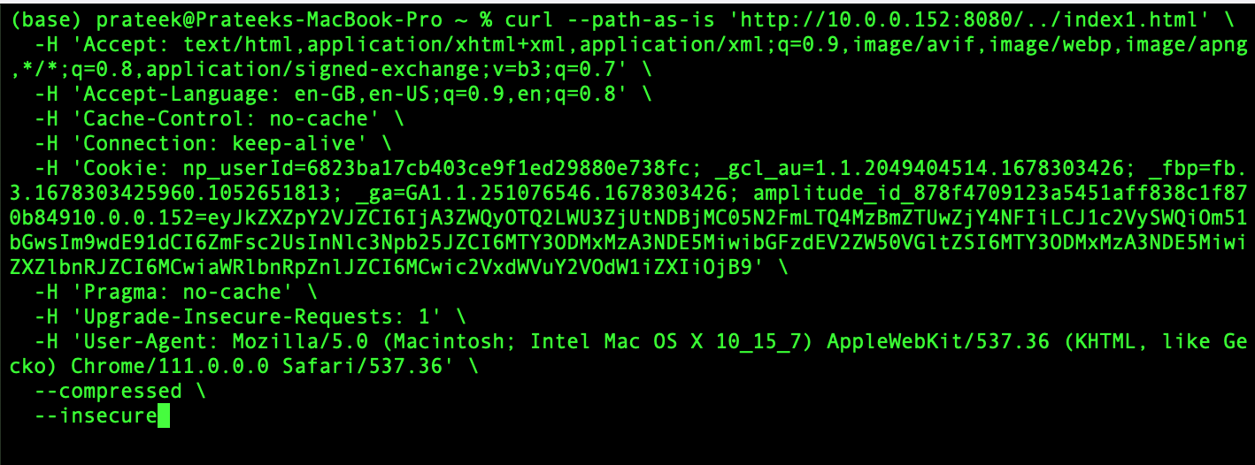
Finding a Vulnerable Extension
HQ Live Server³ - Path Traversal Vulnerability.
Index1.html outside the server’s root folder is served!!
[3] https://github.com/hqjs/vscode-hq-live-server

Slide 8
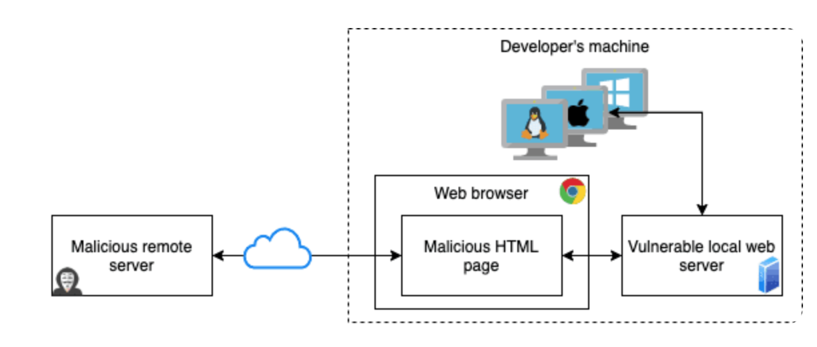
Exploitation Approach
Exploiting the vulnerability to access ~/.ssh/id_rsa.pub.
Challenges:
Protection against XSS
Same Origin Policy
Malicious HTML Page
Vulnerable web server
Run Malicious Webpage on developer’s Machine
Use running server with Path Traversal Vulnerability
Access ~/.ssh/id_rsa.pub

Slide 9
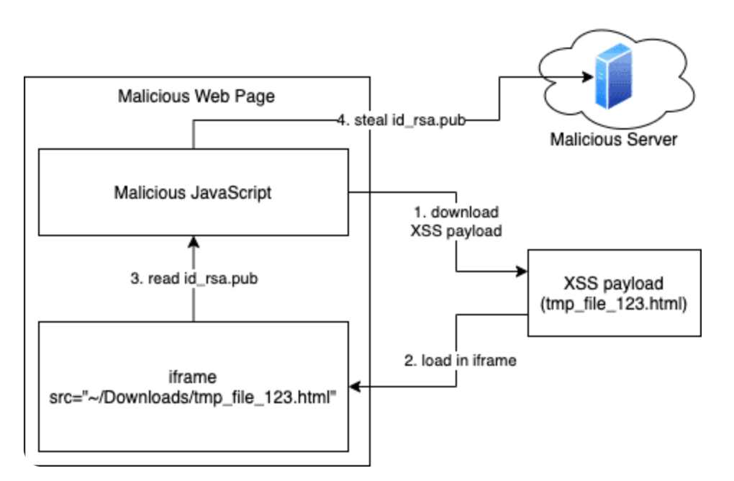
Overcoming the SOP Challenge
4
1
3
2

Slide 10
Progress
Exploited one extension HQ Live Server.
Downloaded the extensions in bulk.
VS Code does not provide any API to achieve this.
Use curl (smartly) inside a python script.
Automated vulnerability testing using available tools.
Package based (Snyk)
Code based (Semgrep)
Way Ahead: Automate vulnerability testing.
Find other extensions with vulnerability.
Activate/run the extension. (Start the server.)
Run test cases from our findings to identify the vulnerabilities.
Group the extensions.

Slide 11
Demo of Exploitation
Open VS Code.
Start the server.
Go to https://files.000webhost.com/
Click on the following link.
https://welcometomywebpage.000webhostapp.com/
Demo Video

Slide 12


Slide 13
Download Extensions in Bulk
Search all the extensions containing given keyword.
Start pulling all the extensions asynchronously.
Run the VS Code on the system.
Unzip the extension locally and read its configurations.
Install the extension on the VS Code.
Hit the URI to load html page locally.
If the response is success, extension is exploitable.
Back

Slide 14
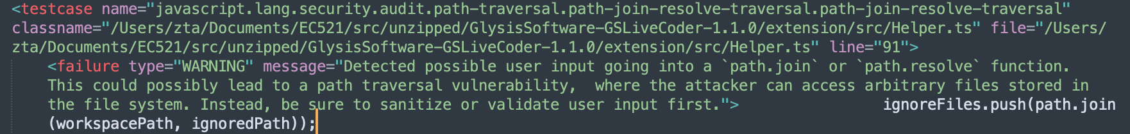
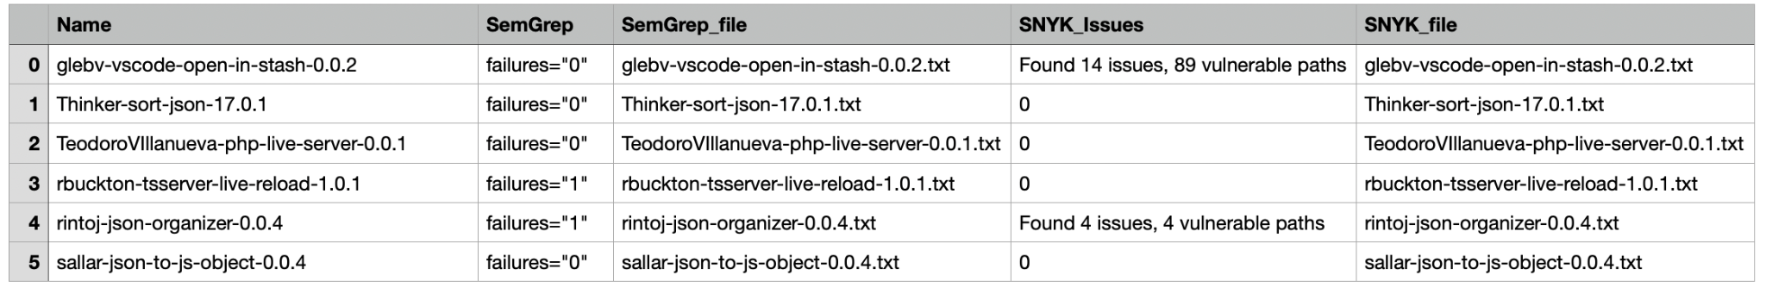
Automate Vulnerability Testing
SNYK
Tests for Security Issues
Combine the Results
Extensions
(.vsix)
Unzip
Extension Folders
SEMGREP
Find Patterns
Back

Slide 15
Supply Chain Attack
Compromise a legitimate package by adding malicious code.
Propagated downstream to applications dependent on package.
Typosquatting or other techniques.
PyPI, NPM, Maven, RubyGems (for Ruby), NuGet (for .NET) etc.
To mitigate the risk of supply chain attacks
Developers should
Use strong passwords and enable two-factor authentication.
Regularly review the packages and dependencies.
Package managers should implement security measures
Code signing, dependency scanning, and package verification.
Back

Slide 16
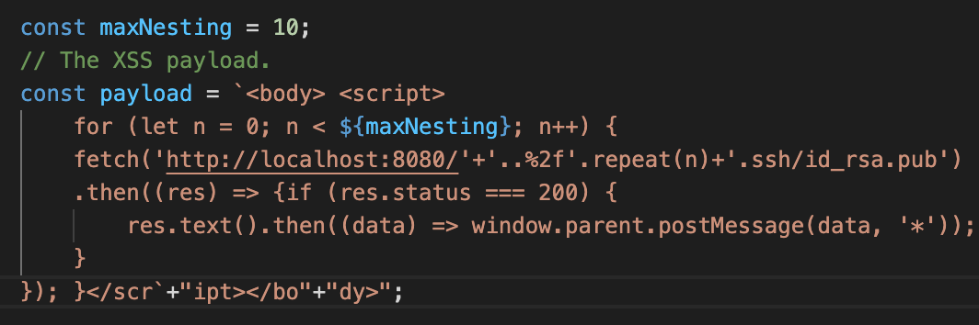
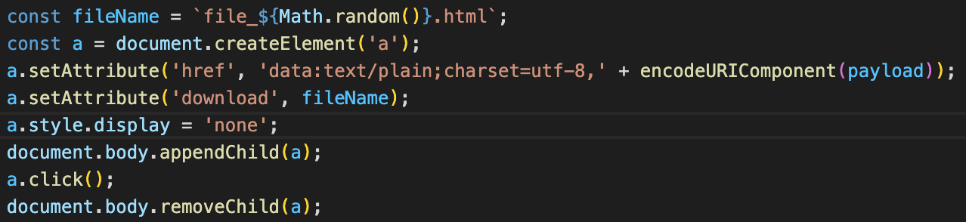
Progress : Exploiting the vulnerable Extension
Creating a Payload.
Download the payload on victim’s system.
Back

Slide 17
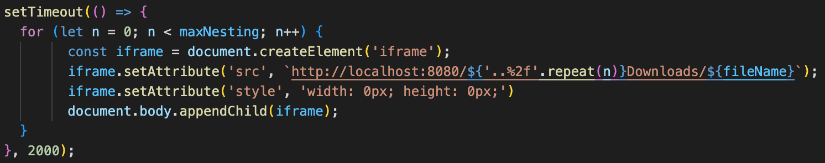
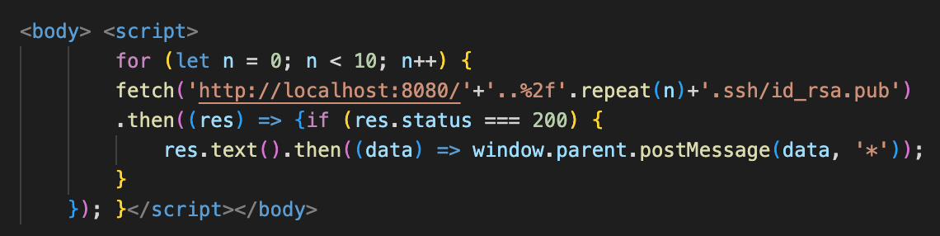
Progress : Exploiting the vulnerable Extension
Load the downloaded payload from victim’s system in an iframe in the browser.
Same Origin
Same Origin
Back

Slide 18
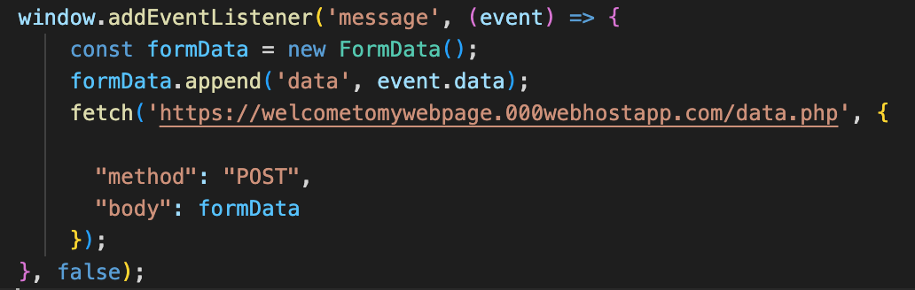
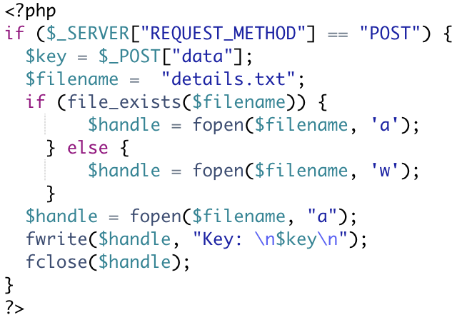
Progress : Exploiting the vulnerable Extension
Send the key to malicious server.
Server-side PHP code.
Back

